Slide 1
PRESENTATION SOFTWARE ENIGINEERING
GROUP MEMBERS: Muhammad Khuzaima Siddiqui (23-Ai-29)
Muhammad Unais (23-Ai-65)
Farman Afzal (23-Ai-73)

Slide 2
TOPICS:
ERP (Enterprise Resource Planning)
Software Prototype

Slide 3
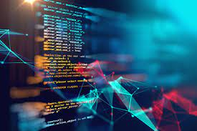
SOFTWARE PROTOTYPE

Slide 4
What is a Software Prototype?
A software prototype is a simplified version of a software application.
It is created early in the development process to explore ideas and gather user feedback.
It help visualize how the final software look and function

Slide 5

Why use a Prototype?
To validate requirements before development begins.
To avoid misunderstandings between clients and developers.
To reduce risk of costly changes later in the project.

Slide 6
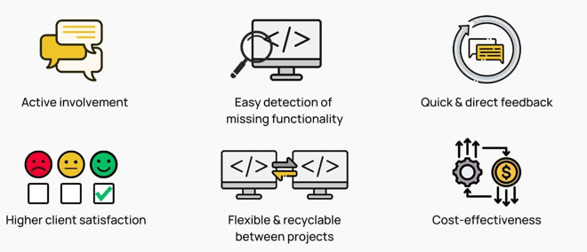
Advantages of Prototyping
Early detection of design and functionality issues.
Better communication with stakeholders .
Improves requirement clarity.
Faster time-to-market.

Slide 7
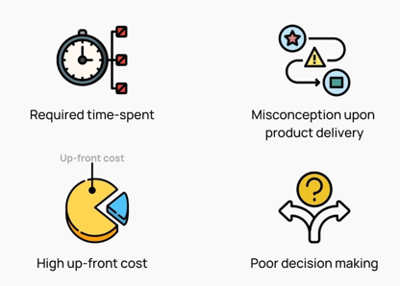
Disadvantages of Prototyping
May lead to false expectations of the final system.
Scope creep due to frequent changes.
Not suitable for large-scale or complex systems in early stages.

Slide 8
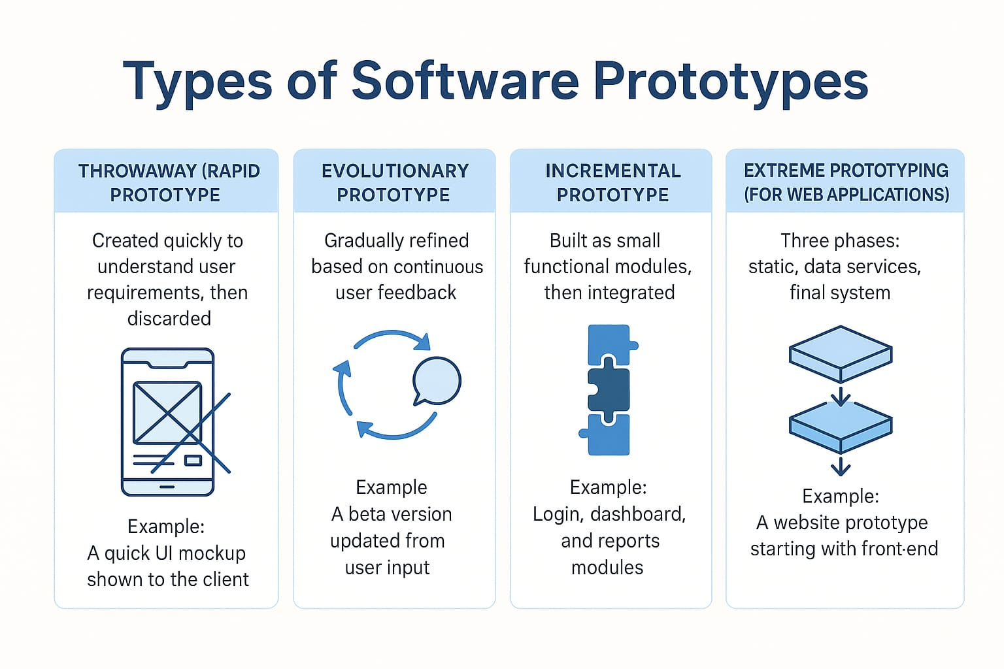
Types of Software Prototypes

Slide 9
Conclusion:
Software prototyping is an essential step in modern software development.
It reduces risks, saves time, and ensures better user satisfaction.
Overall, it leads to a better and more user-friendly final product.

Slide 10
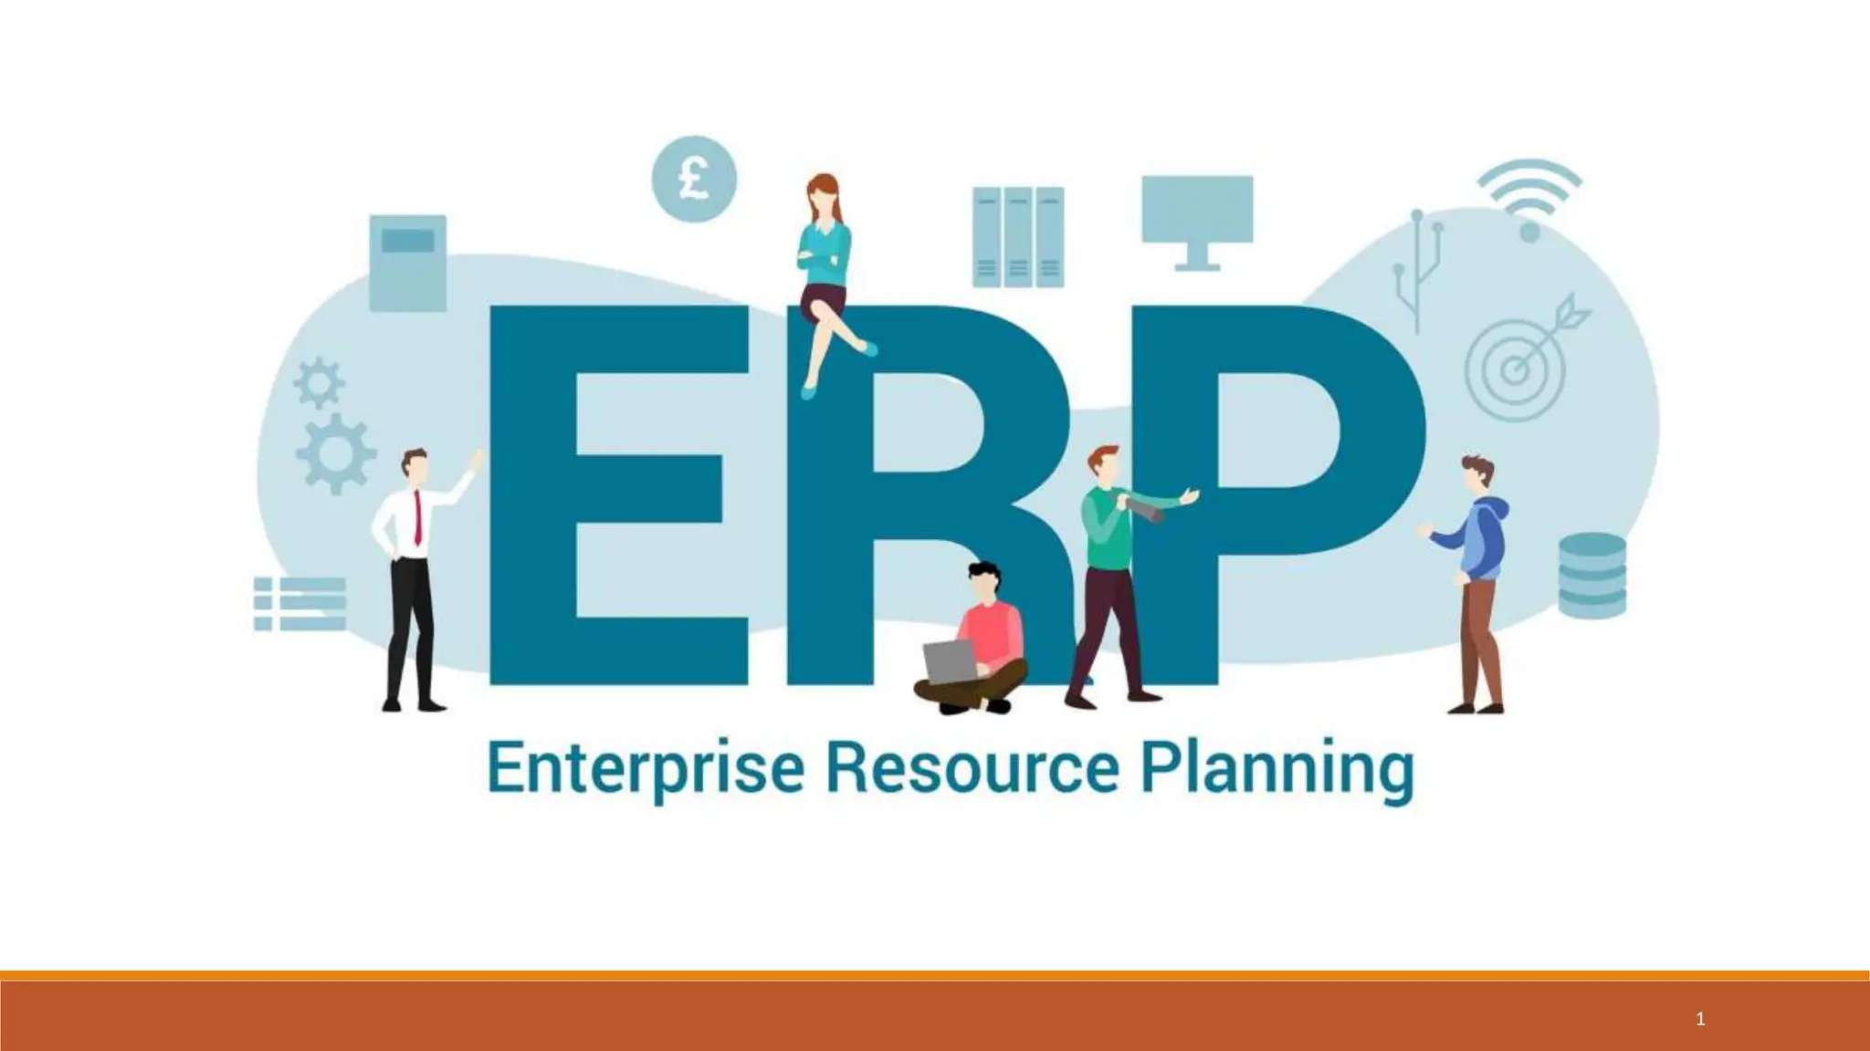

Slide 11





Presentation Overview
Introduction to ERP
Understanding the core concept.
Why ERP Matters
Key benefits and impact.
ERP Modules & How it Works
Exploring components and functionality.
Benefits & Challenges
Outlining pros and cons.
Software & Walmart Case Study
Examples and a real-world application.

Slide 12
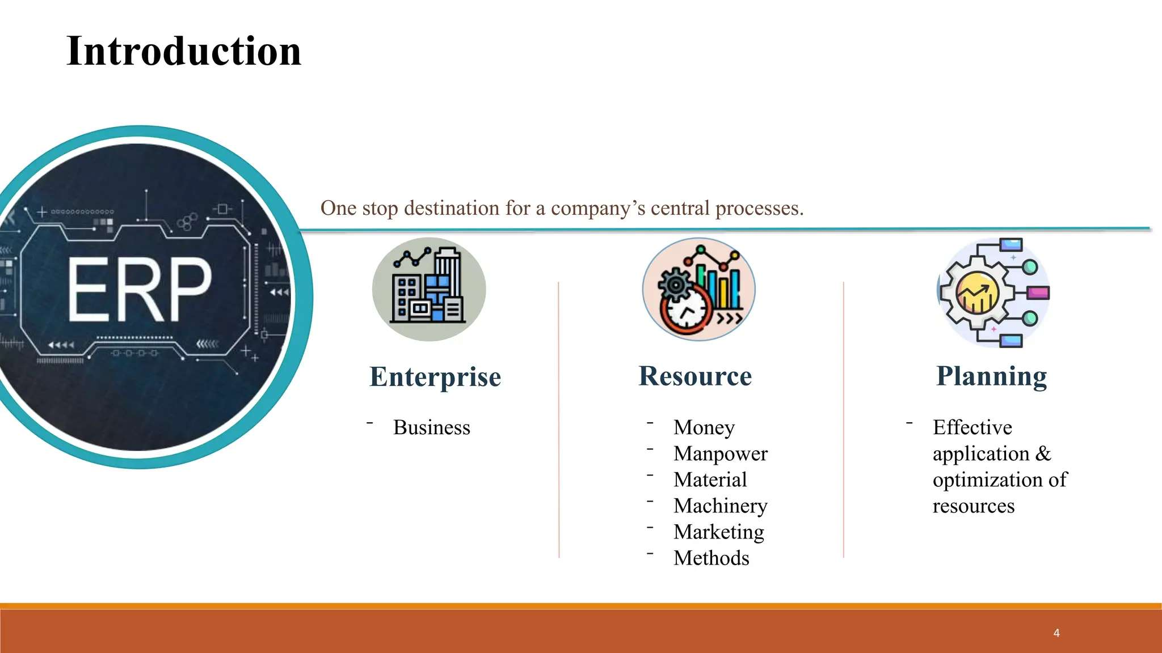

Slide 13





Why ERP is Important?
Centralized Data
Unified access to all information.
Improved Efficiency
Streamlines workflows and productivity.
Better Planning
Enhanced reporting and strategic foresight.
Cost Reduction
Optimizes resources and lowers expenses.

Slide 14

Key Modules of an ERP System
Finance & Accounting
Manages ledgers, payroll, and assets.
Ensures financial compliance.
Human Resource Management (HRM)
Handles employee data, recruitment, and benefits.
Supply Chain Management (SCM)
Oversees logistics, procurement, and inventory.
Customer Relationship Management (CRM)
Manages customer interactions and sales.

Slide 15

How ERP Systems Function
1
Single Platform
All departments integrate on one system.
2
Data Accessibility
Data entered in one module is shared.
3
Automated Updates
Sales orders update inventory and invoices automatically.

Slide 16





Benefits of ERP Implementation
Automation
Error Reduction
Collaboration
Automates business processes.
Minimizes manual errors.
Enhances inter-departmental teamwork.
Scalability
Supports growing business needs.

Slide 17








Challenges in ERP Implementation
Training
Customization
Requires extensive employee training.
Complexity in adapting to specific needs.
High Cost
Data Migration
Significant initial investment.
Difficulties in transferring existing data.

Slide 18
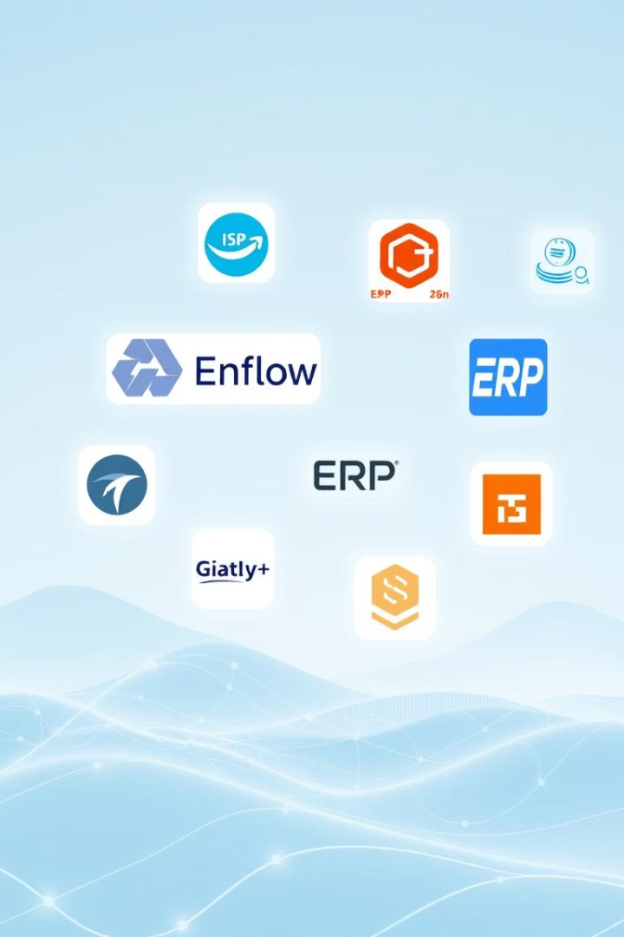
Popular ERP Software Solutions
SAP ERP
A leading global enterprise software.
Oracle ERP Cloud
Cloud-based, comprehensive suite.
Microsoft Dynamics 365
Combines ERP and CRM functionalities.
Odoo
Open-source, modular business apps.

Slide 19

Real-Life Example: Walmart's ERP Success
1
2
Inventory
Supply Chain
Real-time stock monitoring avoided overstocking.
Centralized coordination ensured timely deliveries.
3
4
Financials
Results
Accurate data improved decision-making.
Reduced costs, improved customer satisfaction, efficient global supply chain.

Slide 20
Thank you

